Slide 1
ML for the .NET Developer
Raleigh Code Camp
Jamie Dixon
10/29/2016

Slide 2
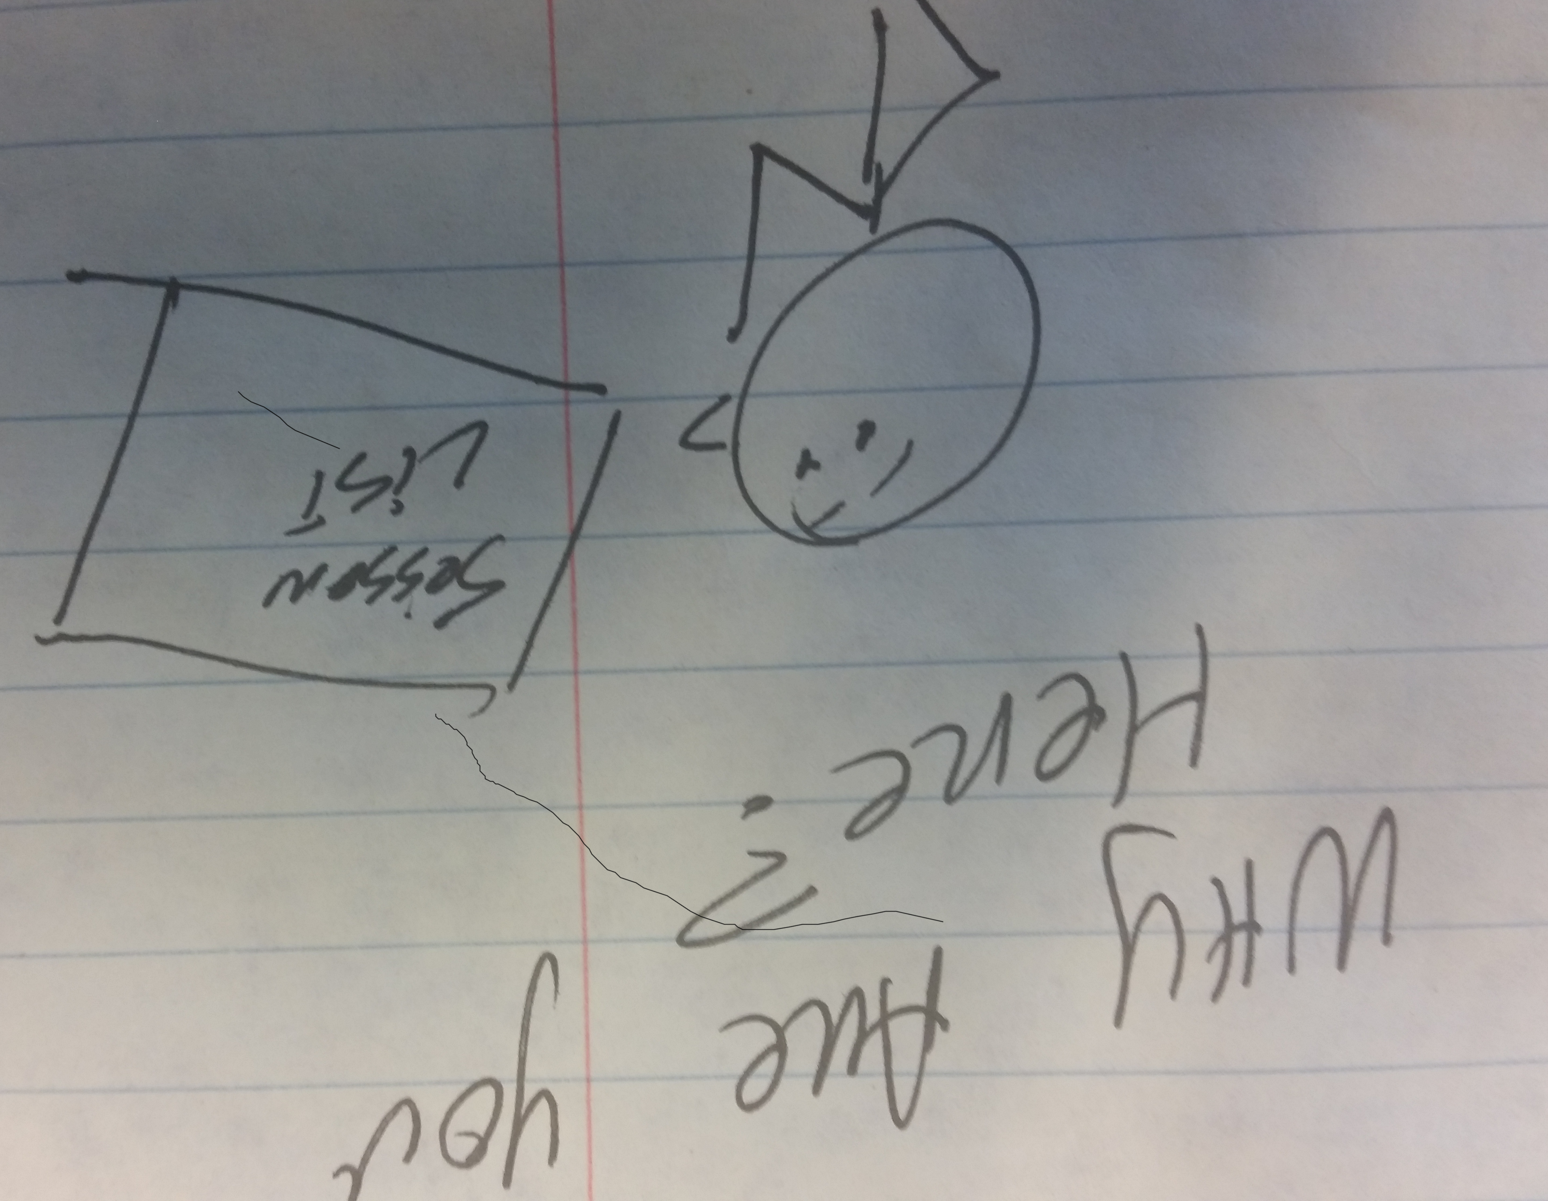
You Are:
A developer wanting to learn about making your applications smarter: the intelligent app is moving CRUD to RIP*
A research analyst/data engineer/report writer being asked to move from descriptive analytics to predictive analytics. “Data Scientist”
Someone who wandered in because the other sessions were full and/or did not look as interesting
*Recommend, Instruct, Predict
Notes:
Recommend
Instruct
Predict

Slide 3
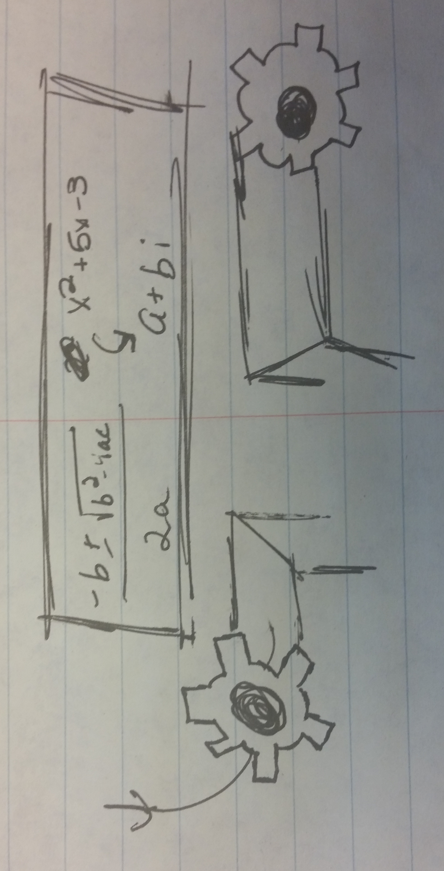
What is Machine Learning?
A technique to train models
A way for applications to change behavior without recompiling.
I, for one, welcome our new overlords
A way for IBM, Microsoft, SAS, Amazon, every consulting company in the world, to sell more product
A way for cranks to sell more books

Slide 4
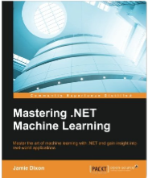
A Word About “Machine Learning”

Slide 5
Data Science Process
Most important step: Ask Question
Most time-consuming step: Prepare Data
Step most likely to get wrong: Test Model
Ask Question
Prepare Data
Select Model
Train Model
Test Model
Conclude
Notes:
ML is in the training of the model

Slide 6

A Word About “Conclude”
Used to look at it and perhaps change
Ad-hoc analysis
Weights were put into prod
Now, more likely to be retrained
Analyze data in motion: Stream processing
Analyze data at rest: Batch processing

Slide 7


Ready For ML?
ETL -> ELt
Question is clearly defined (“sharp”)
Data matches the question
Data is accurate
Have enough data?

Slide 8
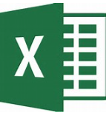




On-Prem Desktop
Use Excel – Analytics Tool pack
Use Power BI
Tableau
Rapid Miner
jmp
Notes:
Excel Example

Slide 9





On-Prem Server
SAS
MatLab
Stick to the Main Frame (Cobol, FORTRAN)
SQL/RServer
Hadoop and/or Spark (Mahout or pyspark)
Notes:
R Server Example

Slide 10
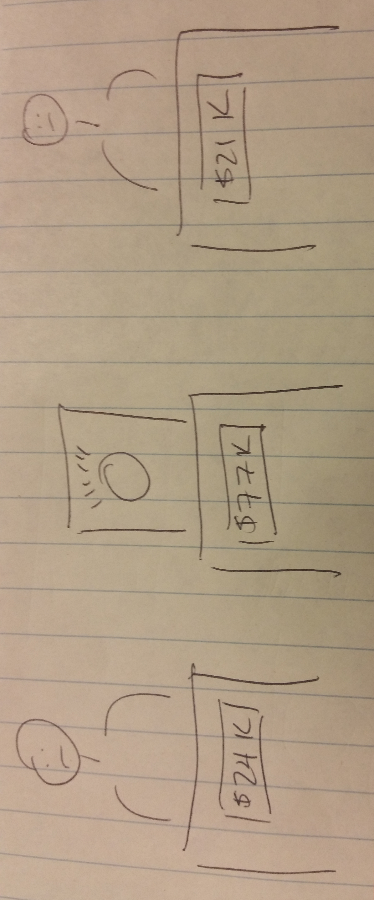
Watson
Notes:
Machine Learning as an api:
Language translation
Question and answer for travel and health care “Does this look infected to you?”
Visualization Rendering
Machine Learning as a service: Watson Analytics
Take data and provide insights
http://www.infoworld.com/article/2822814/machine-learning/ibm-debuts-first-watson-machine-learning-apis.html
http://www.kdnuggets.com/2014/12/ibm-watson-analytics-microsoft-azure-machine-learning-p1.html
Example
https://www.ibm.com/analytics/watson-analytics/us-en/index.html
jamie@chickensoftware.com
1q2w3e4r

Slide 11
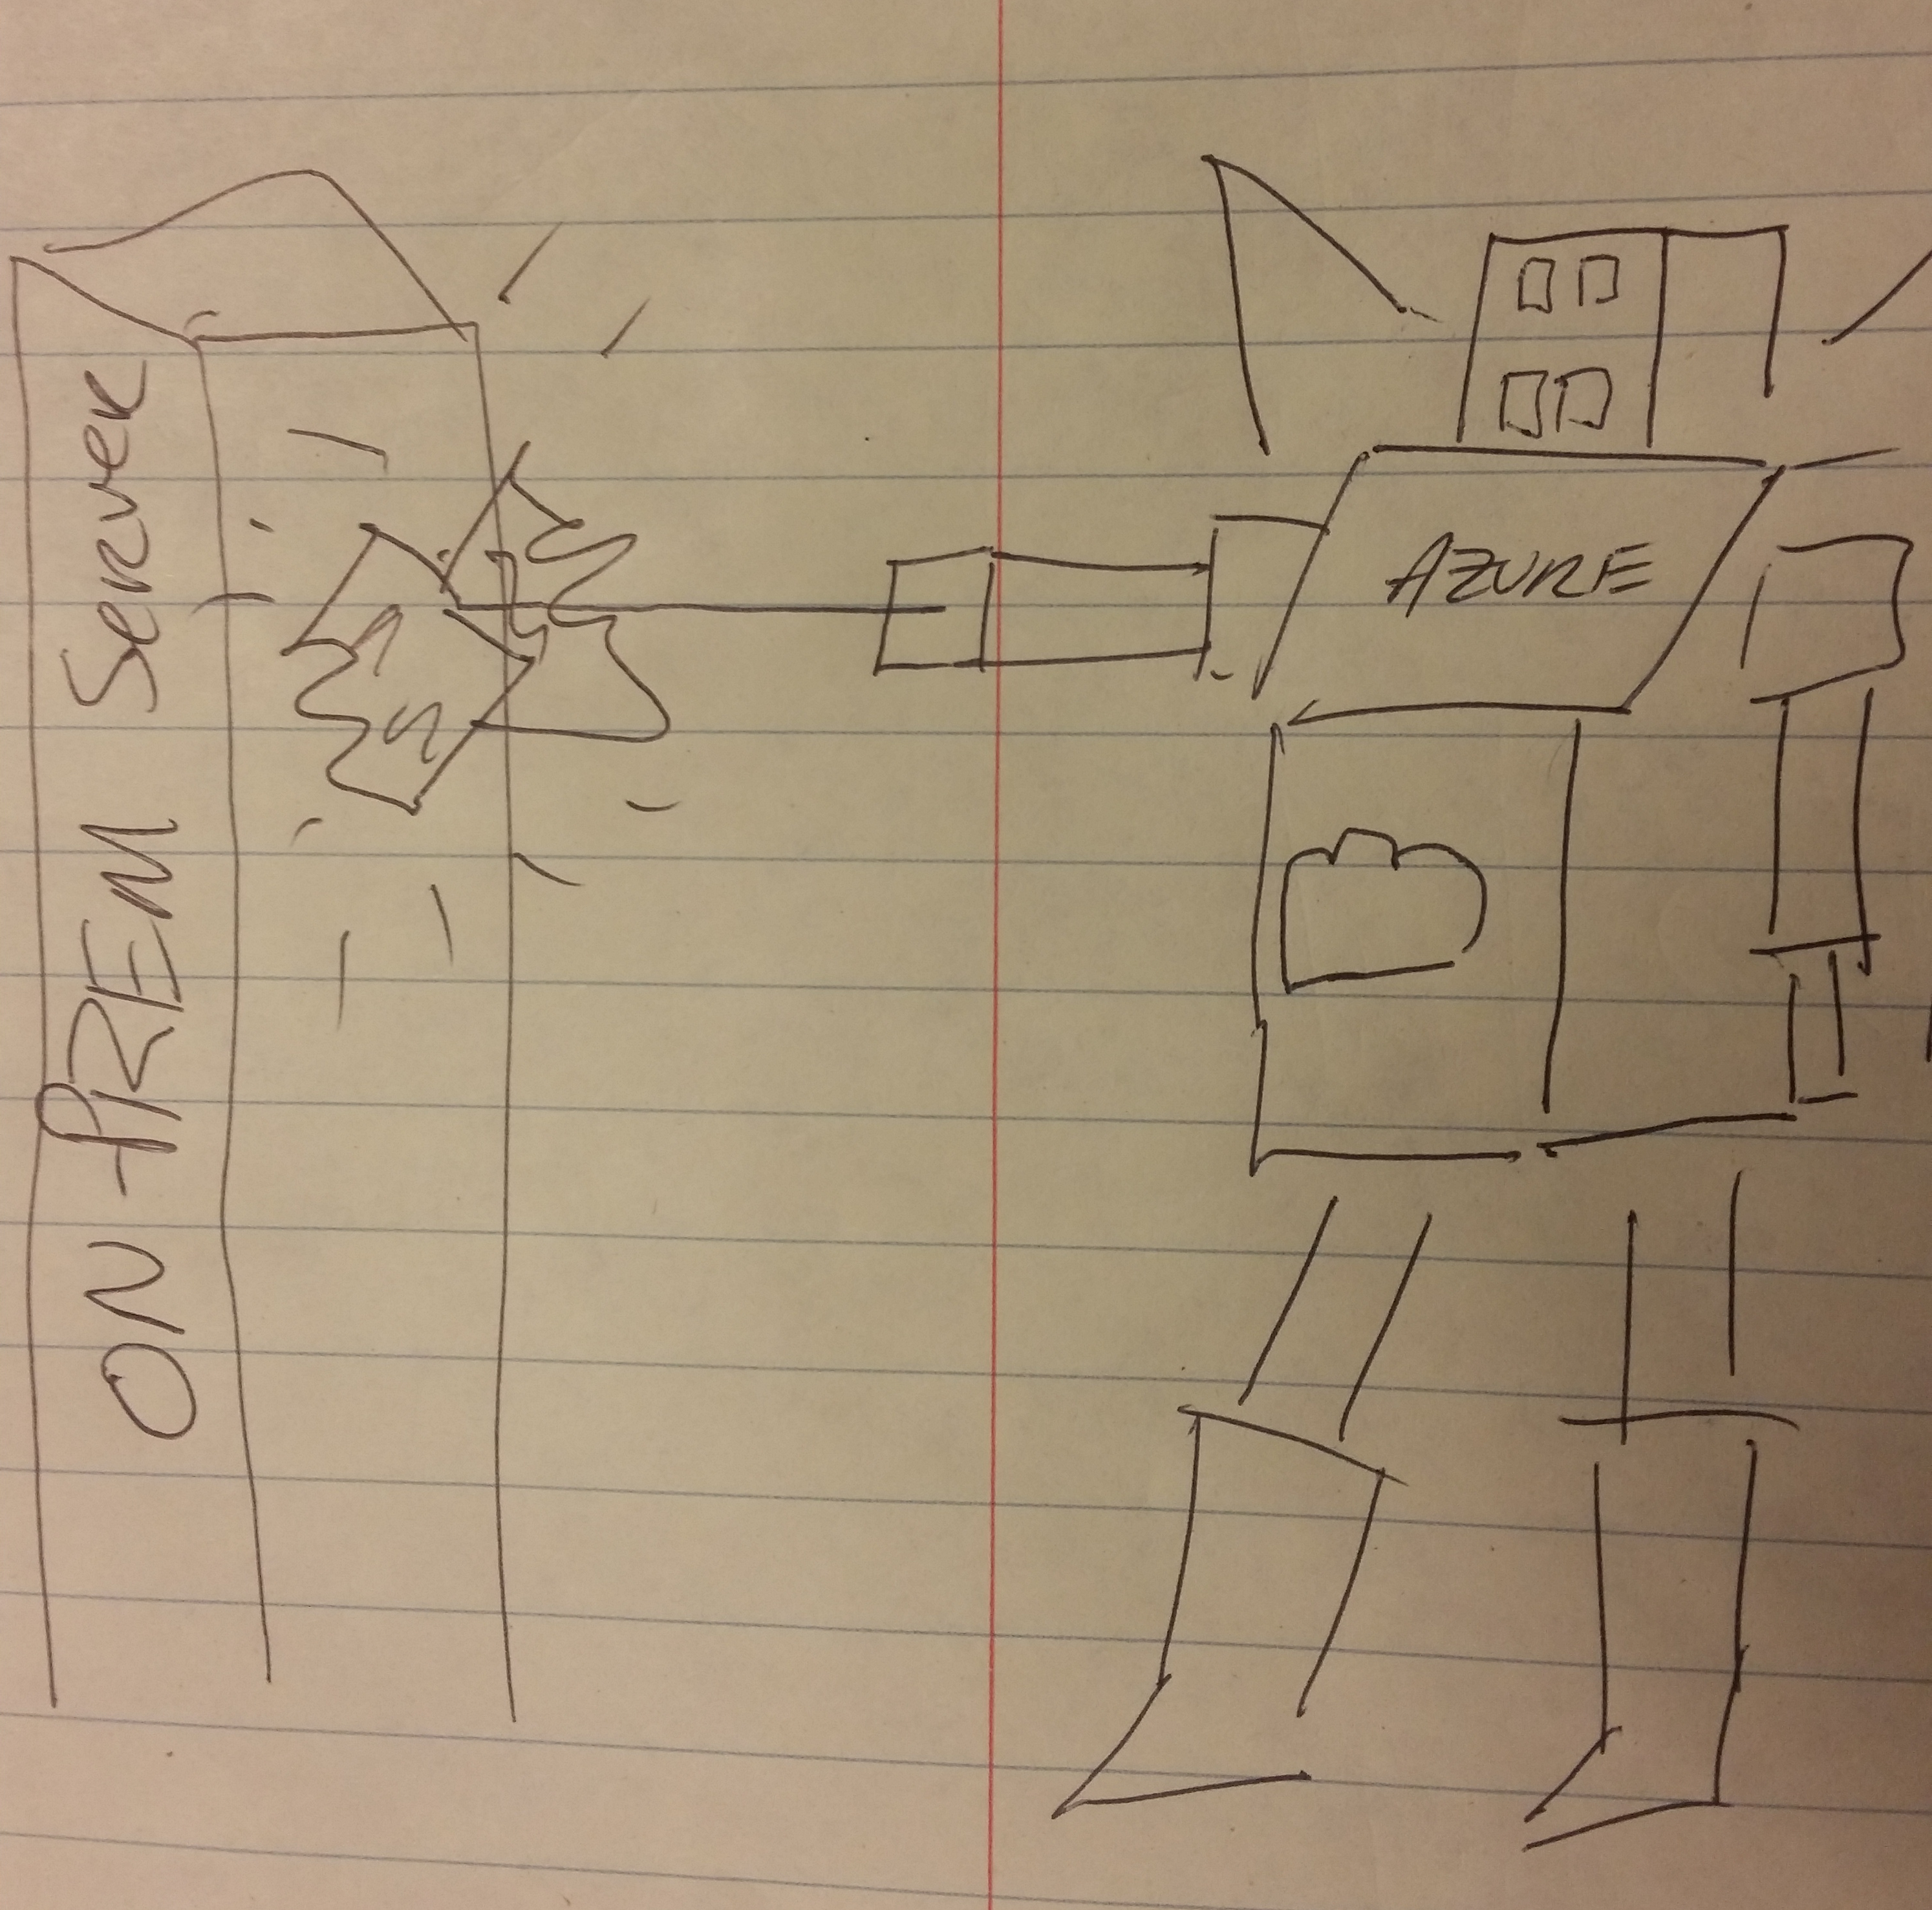
Azure
Notes:
Example
Cognitive Services Api:
https://www.microsoft.com/cognitive-services/
Speech conversion and translation
Facial recognition ~ Emotion, face,
Language understanding
Recommendation engine
Azure ML
“Drag and Drop” data science

Slide 12

AWS
Notes:
https://blogs.aws.amazon.com/bigdata/post/Tx2OZ63RJ6Z41A0/Building-a-Numeric-Regression-Model-with-Amazon-Machine-Learning
Example

Slide 13

.NET
Notes:
Accord .NET
Numl
Encog .NET
alglibnet

Slide 14
Conclusion
What is your arc?
Nail the question, the rest will follow
The more willing you are to learn, the better off you will be

